Slide 1
Lifestyle Predictors of Stroke
DATS 6103 Final Project
Team 2
Akshat Saini, Xiao Qi, Keelin Arseneault

Slide 2

Overview
A stroke occurs when blood flow to the brain is blocked, often leading to long term disability or death.
The World Health Organization states that stroke is the second highest cause of death around the world, leading to 11% of total deaths.
Stroke-related costs in the United States came to nearly $53 billion between 2017 and 2018.
Google Images https://www.cdc.gov/stroke/facts.htm

Slide 3

SMART Questions
Overall
What factors or variables affect the likelihood of a person having a stroke?
Can we predict if someone will have a stroke based on their health and lifestyle?
EDA
What are the relationships between stroke and quantitative variables in the dataset (BMI, age, glucose level, etc.)?
Is a particular gender affected more from heart disease or hypertension?
Do marriage status and residence type contribute to having a stroke?

Slide 4
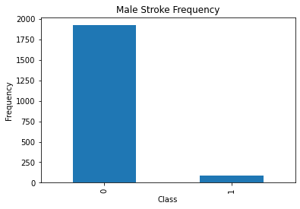
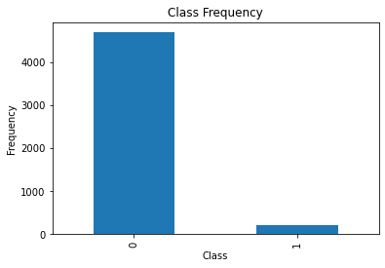
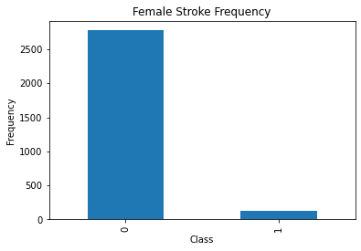
Unbalanced Data
0 = No stroke
1 = Stroke

Slide 5
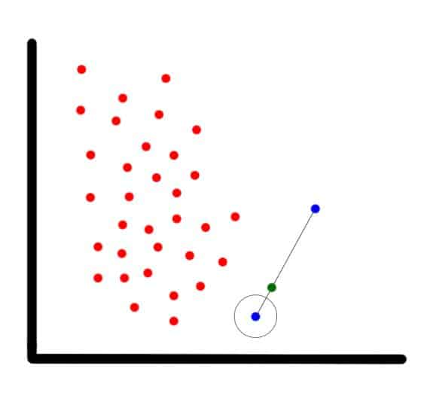
SMOTE
Balanced the data set using SMOTE: Synthetic Minority Oversampling Technique.
Using this method, as the name suggests, the minority target variable is oversampled using artificial or synthetic values.
The technique uses the concept of K-NN or K nearest neighbors to intelligently generate synthetic data which resembles the values or shape of the outnumbered data instead of directly copying or reusing pre-existing values.
For more info: https://github.com/scikit-learn-contrib/imbalanced-learn

Slide 6
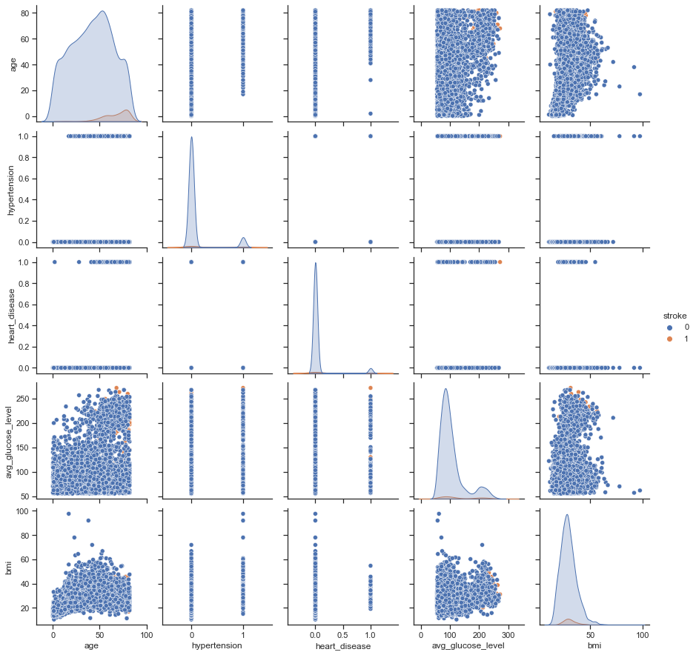
EDA
Pairs plot confirms unbalanced dataset issue
Can still observe some relationships between stroke and quantitative variables related to health

Slide 7
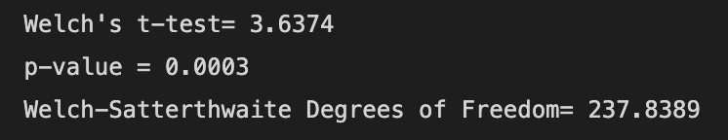
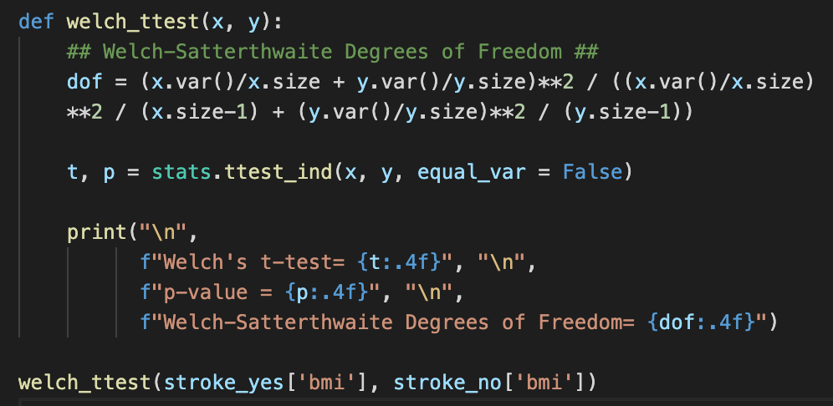
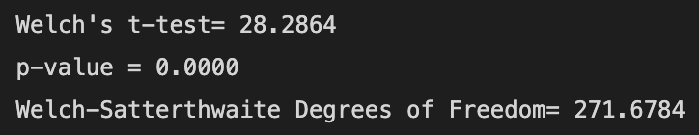
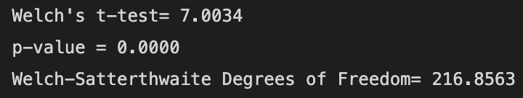
Statistical Testing
Welch’s T-test for Unbalanced Sample Sizes
BMI
Age
Glucose

Slide 8
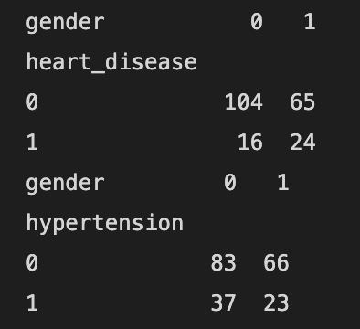
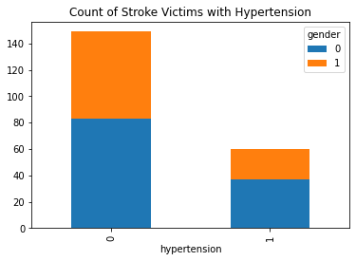
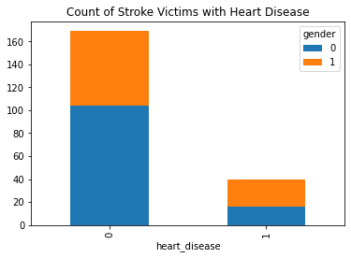
Heart Disease and Hypertension by Gender
Gender
1 = Male
0 = Female

Slide 9
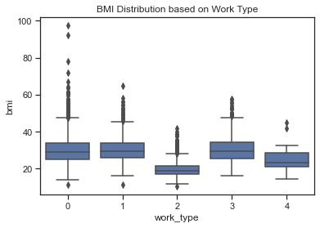
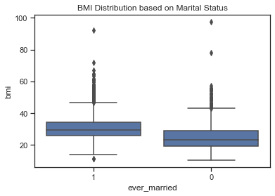
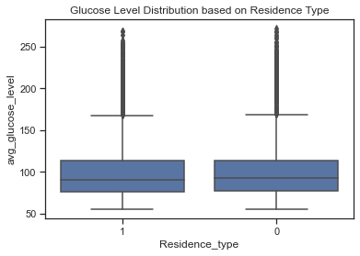
Closer Look at Lifestyle Factors

Slide 10
Modeling
Logistic Regression with Cut-off Value
KNN
Logistic Regression with SMOTE
Decision Tree

Slide 11
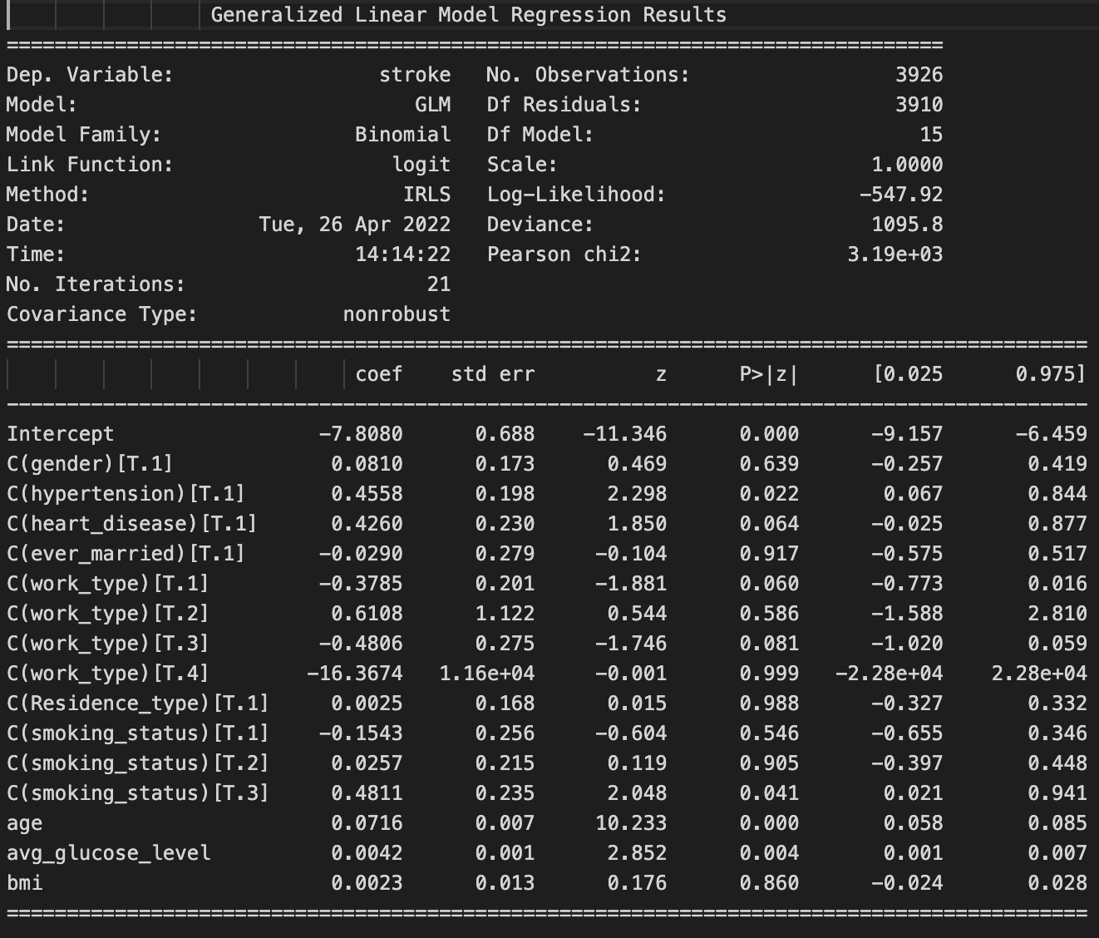
Logistic Regression
Cut-off Value
Stroke | 0 | 1
count | 4699 | 209
ratio | 0.957 | 0.043
data
80% data_train
20% data_test
Notes:
In this part, I want to use the data to predict the stroke. so people can take some actions like a more detailed physical examination before the conditions become worse.
We know that the data here is unbalanced, so I built a logistic regression model with a different cutoff value.
To train and evaluate the model, I split the dataset into two parts. 80 percent of the dataset will be used to train the model and the rest will be used to test the accuracy of the model.
The first model is in the right. You can find that the p-values of some variables are larger than 0.05, which are not significant so I just dropped these variables and built the second model.

Slide 12
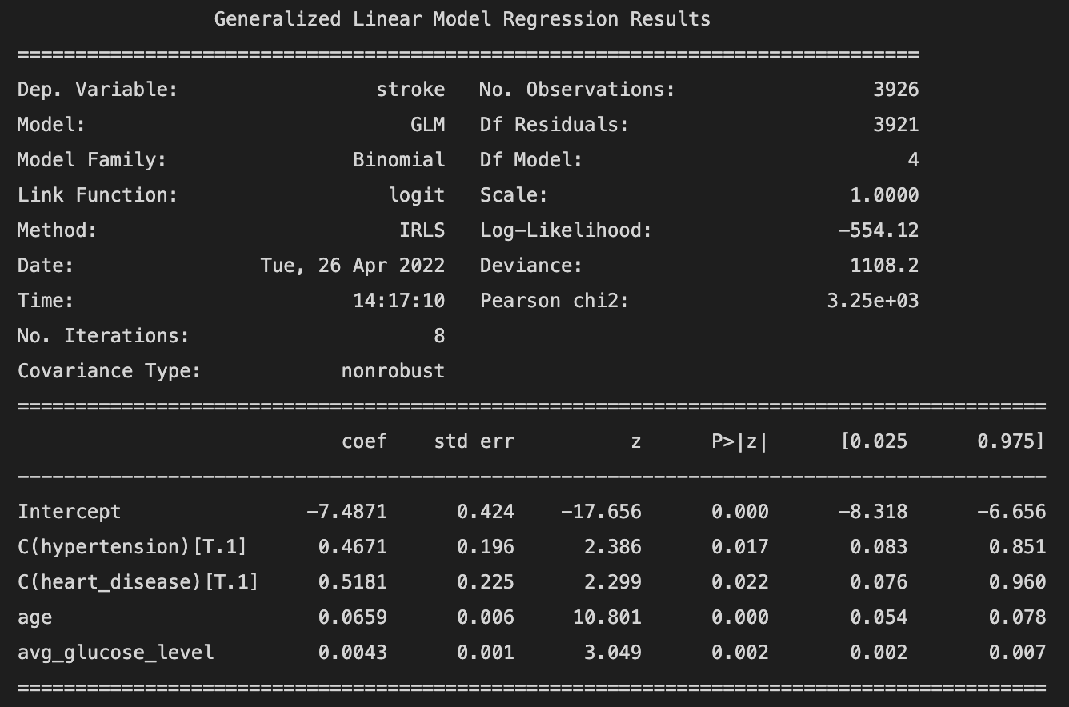
Logistic Regression
Cut-off Value
variables | VIF
hypertension | 1.10
heart_disease | 1.08
avg_glucose_level | 1.10
age | 1.18
Intercept | 8.80
glm(formula='stroke ~ age + C(hypertension) + C(heart_disease) + avg_glucose_level', data=…)
Notes:
The second model is reliable. And the Variance Inflation Factor for all variables are all smaller than 10. which means there is no highly correlation between variables.
And at the bottom is the formula for the logistic regression model.

Slide 13
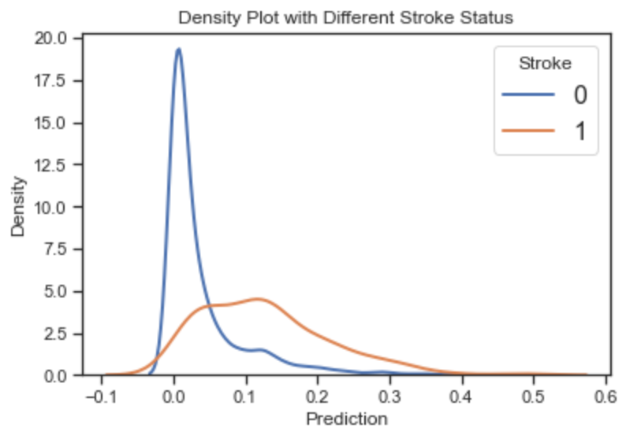
Logistic Regression
Cut-off Value
The prediction gets pulled towards a lower number because the majority of the data are zero (healthy) instances.
Notes:
Let’s have a quick look of our prediction first.
The graph here is the predicted value for healthy people and for people having stroke. orange line is the people who have stroke and the blue line is the healthy people. Both the probability of people with stroke and healthy person are lower than 0.5. It is because the majority of the data are zero (healthy) instances.

Slide 14
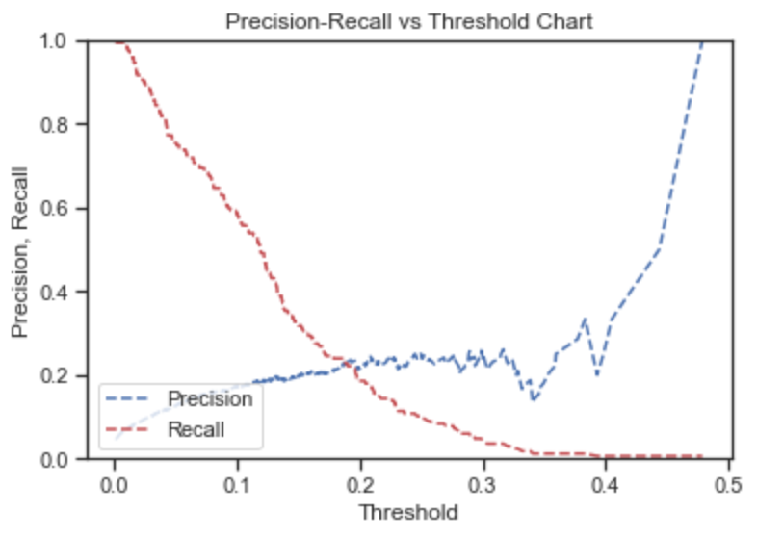
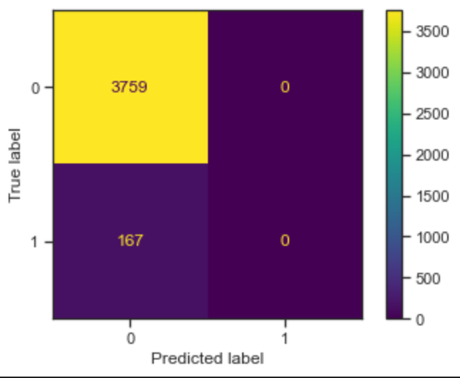
Logistic Regression
Cut-off Value
Confusion Matrix when Cutoff Value is 0.5
precision = 1, recall = 0
Notes:
Then, we can have a look using the visualization of confusion matrix.
We can find from this picture that when the cutoff is 0.5, there is no number of False Positive FP. So the precision will be 1. But the recall now is 0 because there is no True Positive TP.
Because the number of stroke instance is low, our model will be likely to make a false negative mistake. 0.5 is not a suitable cutoff value.
Then we can have a look of the model’s precision and recall with different cutoff value. When we add cutoff value, we increase the precision. But we decrease recall.

Slide 15
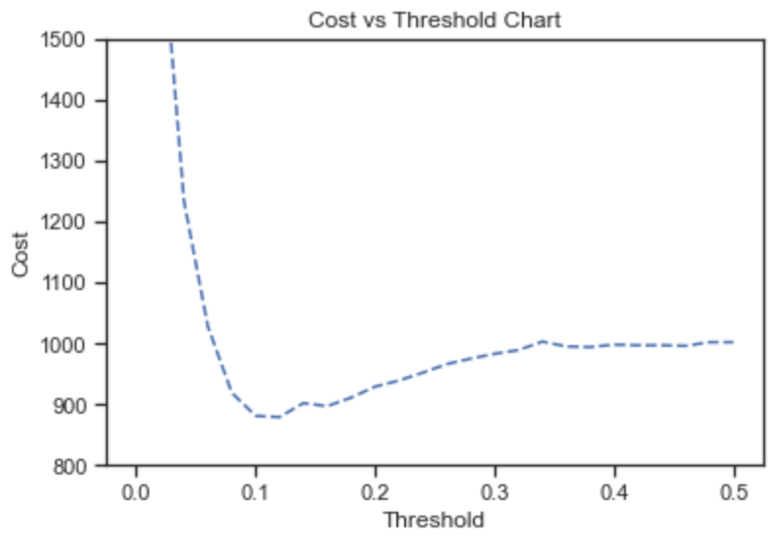
Logistic Regression
Cut-off Value
FN (a stroke instance but not find) and FP (a healthy people but predicted stroke) have different costs:
cost_FN = 6
cost_FP = 1
A suitable cutoff value = 0.1
Notes:
So what is a suitable cutoff value?
when we have a FN (a stroke instance but not find), the wrong prediction may injury their life. But for a FP (a healthy people but predicted stroke), they just need a more detailed physical examination. So a FN is more costly than a FP for our project. So set cost_FN = 6, cost_FP = 1. We can get a graph of the total cost in different cutoff value.
And it apparently, the suitable cutoff value is 0.1

Slide 16
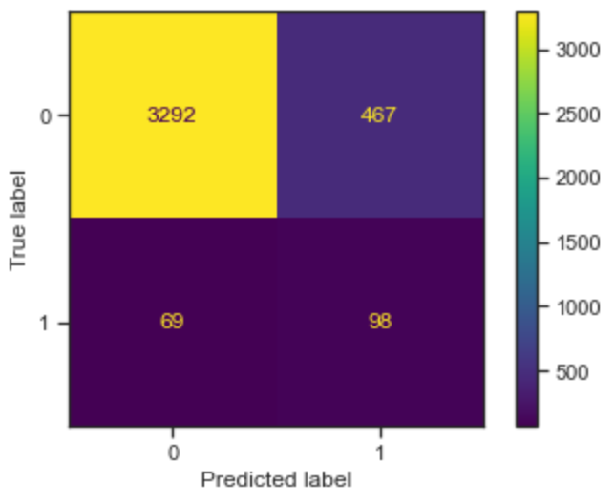
Logistic Regression
Cut-off Value
Our classification model is making less false negative (FN) error, since the cost associated with it is 6 times higher than a false positive (FP).
Notes:
We can re-plot the confusion matrix to see what happened when we switch to the new cutoff value.
Our classification model is making less false negative (FN) error, since the cost associated with it is 6 times higher than a false positive (FP).

Slide 17
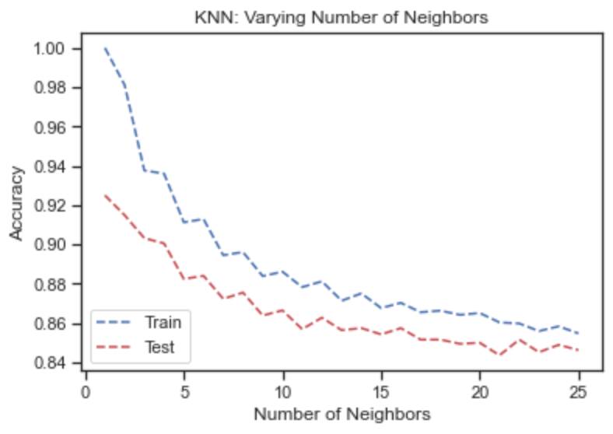
KNN
1. Using SMOTE to balance the dataset
2. Split the dataset to train and test
3. Decide the best K for KNN
Notes:
Then, I built a knn model. Unlike the model before, this time, I used balanced dataset by SMOTE. I split the dataset into train and test. And I compared the accuracy of train dataset and test dataset to find out the best K for this model.
Considering that the k should be an odd number. And a small k may cause overfitting and a large k will cause underfitting. I choose 7 as the k.

Slide 18
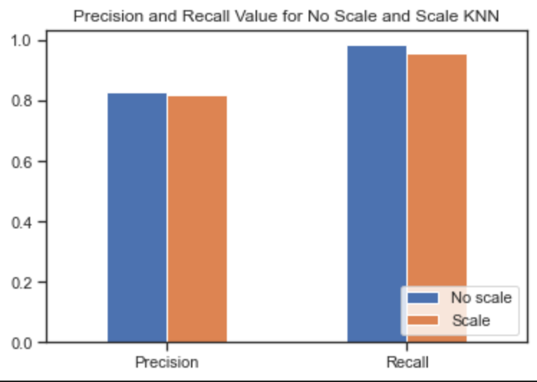
KNN
Our models are good, but It’s weird that no scaled dataset has a higher recall.
Notes:
Then I compared the knn model with scaled data and without scaled data. It’s weird because I thought the scale dataset will have higher precision and recall but it not.
And I guess it’s related to the SMOTE oversampling, SMOTE use KNN with unscaled dataset to generate data that stroke = 1.

Slide 19
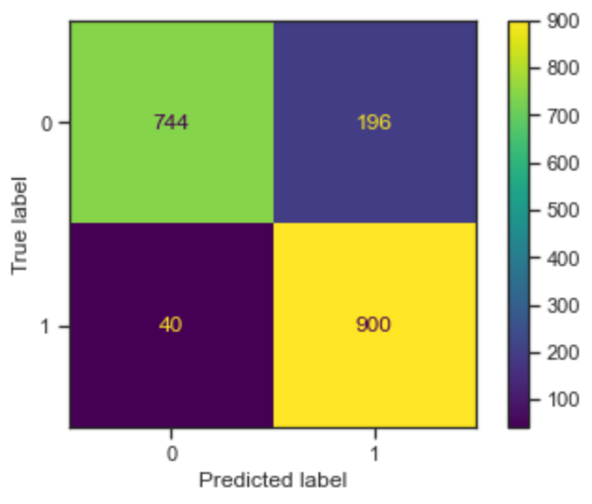
KNN
Confusion Matrix Using Scaled Test Dataset
Precision = 0.82, Recall = 0.96
Notes:
And there is the confusion matrix using scaled test dataset. the precision is 0.82 and recall is 0.96.

Slide 20
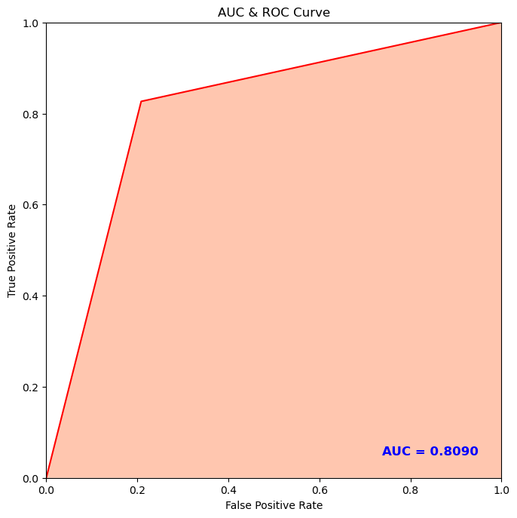
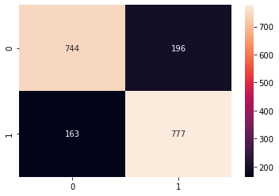
Logistic Regression
Balanced using SMOTE
data
80%
Training Set
20%
Test Set

Slide 21
Model Classification Report
 | PRECISION | RECALL | F1-SCORE | SUPPORT
0 | 0.83 | 0.80 | 0.82 | 940
1 | 0.81 | 0.84 | 0.82 | 940
ACCURACY |  |  | 0.82 | 1880
MACRO AVG. | 0.82 | 0.82 | 0.82 | 1880
WEIGHTED AVG. | 0.82 | 0.82 | 0.82 | 1880

Slide 22
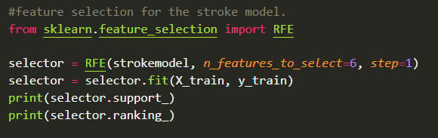
Feature Selected Logit Model
[ True False True True True True True False False False]
[1 2 1 1 1 1 1 5 4 3]
Residence type, work type, married status, heart disease, hypertension, and gender have more variance on the target variable than other variables.

Slide 23
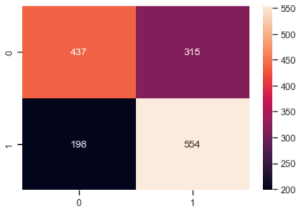
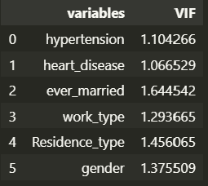
Multicollinearity Test and Model Performance
Since all the variables had a vif value in the range of 1 to 2, the model has no problem of multicollinearity.
AUC: 0.659

Slide 24
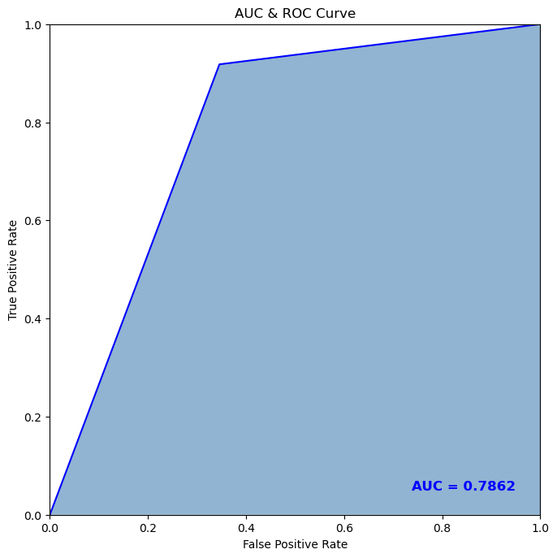
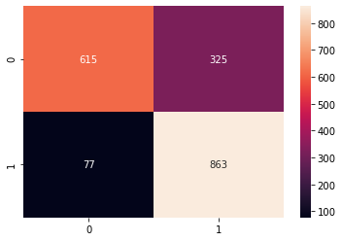
Decision Tree - Classification
data
80%
Training Set
20%
Test Set

Slide 25
Tree Model Classification Report
 | PRECISION | RECALL | F1-SCORE | SUPPORT
0 | 0.91 | 0.65 | 0.76 | 940
1 | 0.73 | 0.93 | 0.82 | 940
ACCURACY |  |  | 0.79 | 1880
MACRO AVG. | 0.82 | 0.79 | 0.79 | 1880
WEIGHTED AVG. | 0.82 | 0.79 | 0.79 | 1880

Slide 26
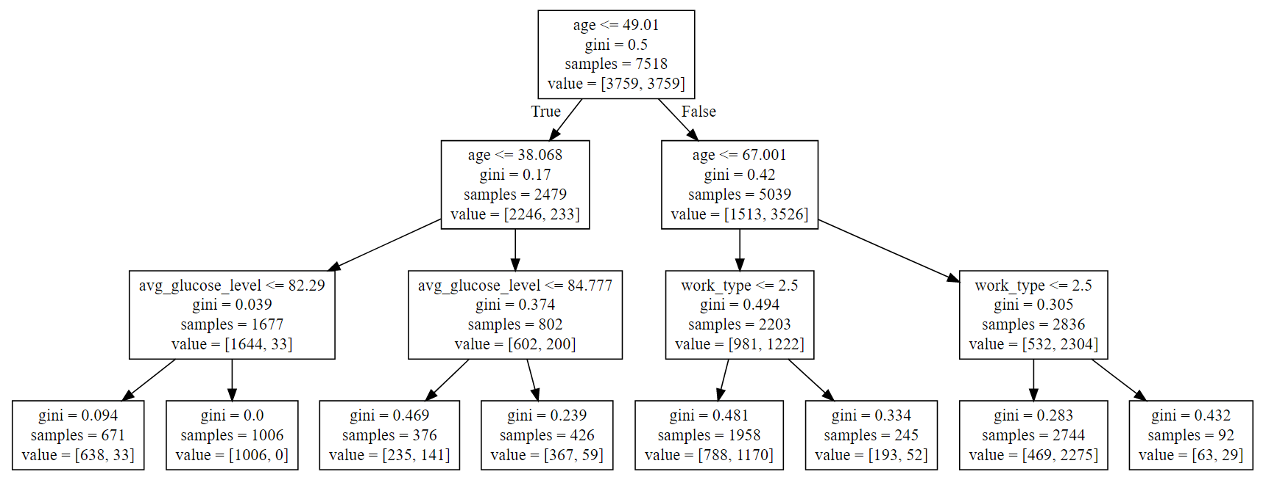
Tree Structure using Graphviz
GINI - Randomness in Selection
ENTROPY - Information Gain

Slide 27
Model Comparison and Summary
MODEL | ACCURACY | RECALL | AUC
STAT MODEL LOGIT (Imbalanced) | 0.18 | 0.57 | 0.73
KNN (Balanced, Scaled, n = 7) | 0.82 | 0.96 | 0.87
KNN (Balanced, Not-Scaled, n = 7 | 0.83 | 0.99 | 0.89
LOGIT - 1 (Balanced) | 0.81 | 0.83 | 0.81
LOGIT - 2 (Balanced + Feature Selected) | 0.66 | 0.72 | 0.66
CLASSIFICATION TREE (Balanced) | 0.79 | 0.93 | 0.79
AUC - Area Under ROC Curve
ACCURACY -
(TP + TN) / Total
RECALL -
TP / (TP + FN)

Slide 28
Conclusions
Balancing a data set like this is required to build a decent model.
EDA revealed significant difference between quantitative variables (BMI, age, glucose) in stroke vs. non-stroke participants, but modeling/feature selection process suggested they were less important while categorical variables were more important.
Feature selection suggests that Residence_type- Urban or Rural and marital status of a person has more variance on stroke than age or smoking!
KNN or K-Nearest Neighbors Model performs best for this set of categorical data points with N set to 7.

Slide 29
Questions?
Thanks for Listening!

